Slide 1
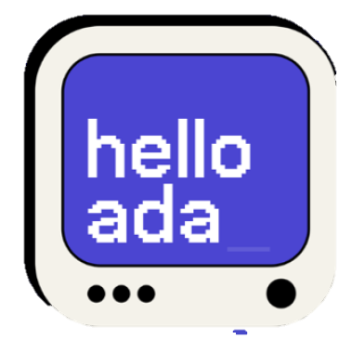
“hello ada” AI toolbox
Presented By : Bootcamp Team
Arranged by : Redi School of integration Copenhagen , Denmark.

Slide 2
Introduction
We are team of 4.
We are working with Nermeen who created “hello ada” app for kids to have fun and entertainment on mobile phone, tablets, iPad, Laptop, and MacBook etc.
In her app we are crating AI toolbox which can generate text, images and voice for making creative content by kids.

Slide 3
Our Team
AMARA
Front/End Developer
HARSHITA
Front/End Developer
SAIMA
Front/End Developer
ANJALI
UX Designer
hello ada AI toolbox

Slide 4
hello ada AI toolbox
Project Overview Creation of AI toolbox for hello ada app.
Targeted Audience Parents & kids
Project Goal Create AI toolbox for kids using digital platform by hello ada application, Which can generate text, pictures and voice for entertainment on mobile phone , tablet, MacBook, iPad .
Project Timeline 3 weeks with a team of fantastic four

Slide 5
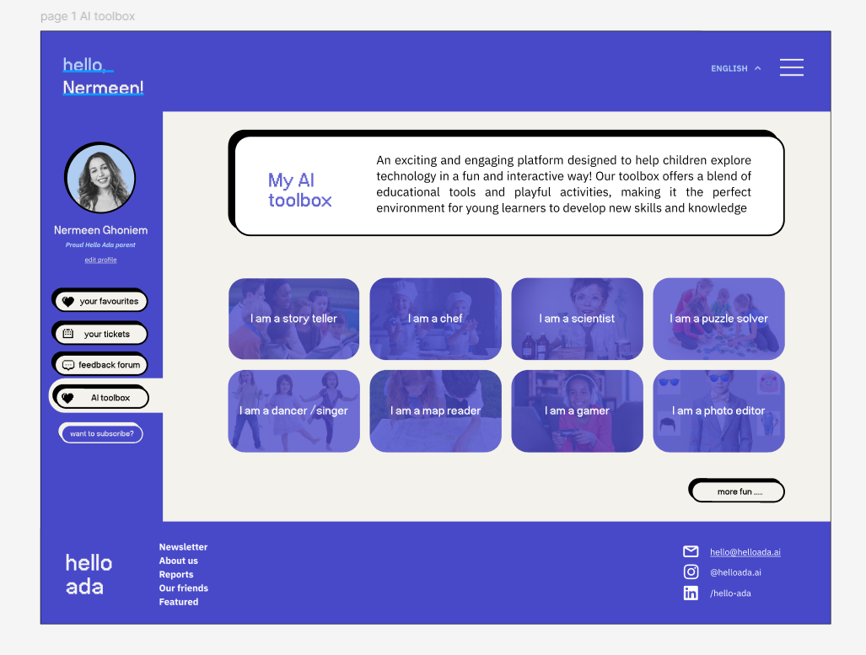
1st wireframe showing AI toolbox content

Slide 6
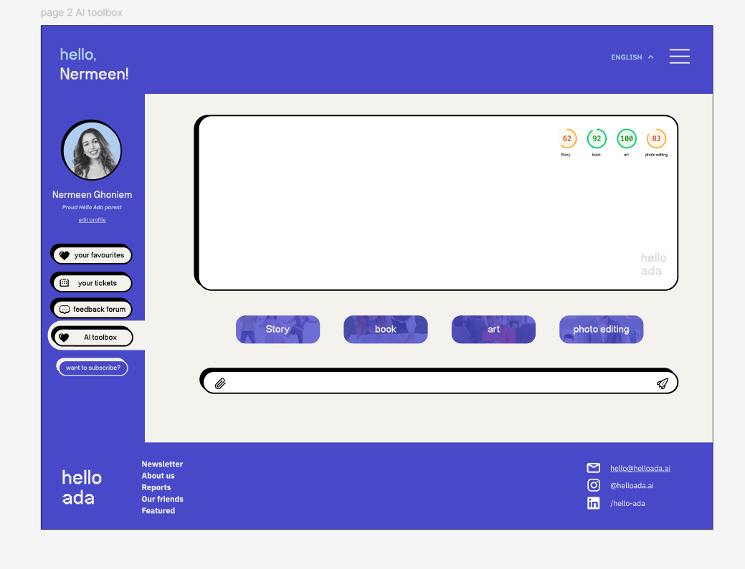
2nd wireframe showing how it helps to create content generating text , image and voice

Slide 7
We designed one persona and designed accordingly
Persona Sofia who is single mother and looking for an activity which involves creativity, fun and entertainment for her daughter who is hyper active .
As hello ada involved kids to play with AI tool box to explore their fun and entertainment with creative content and using their computer skills as well by using their screentime fruitful way is also an advantage for kids
So Sofia uses this app for her daughter make her focus and increase her creativity and fun time in the entertainment.

Slide 8
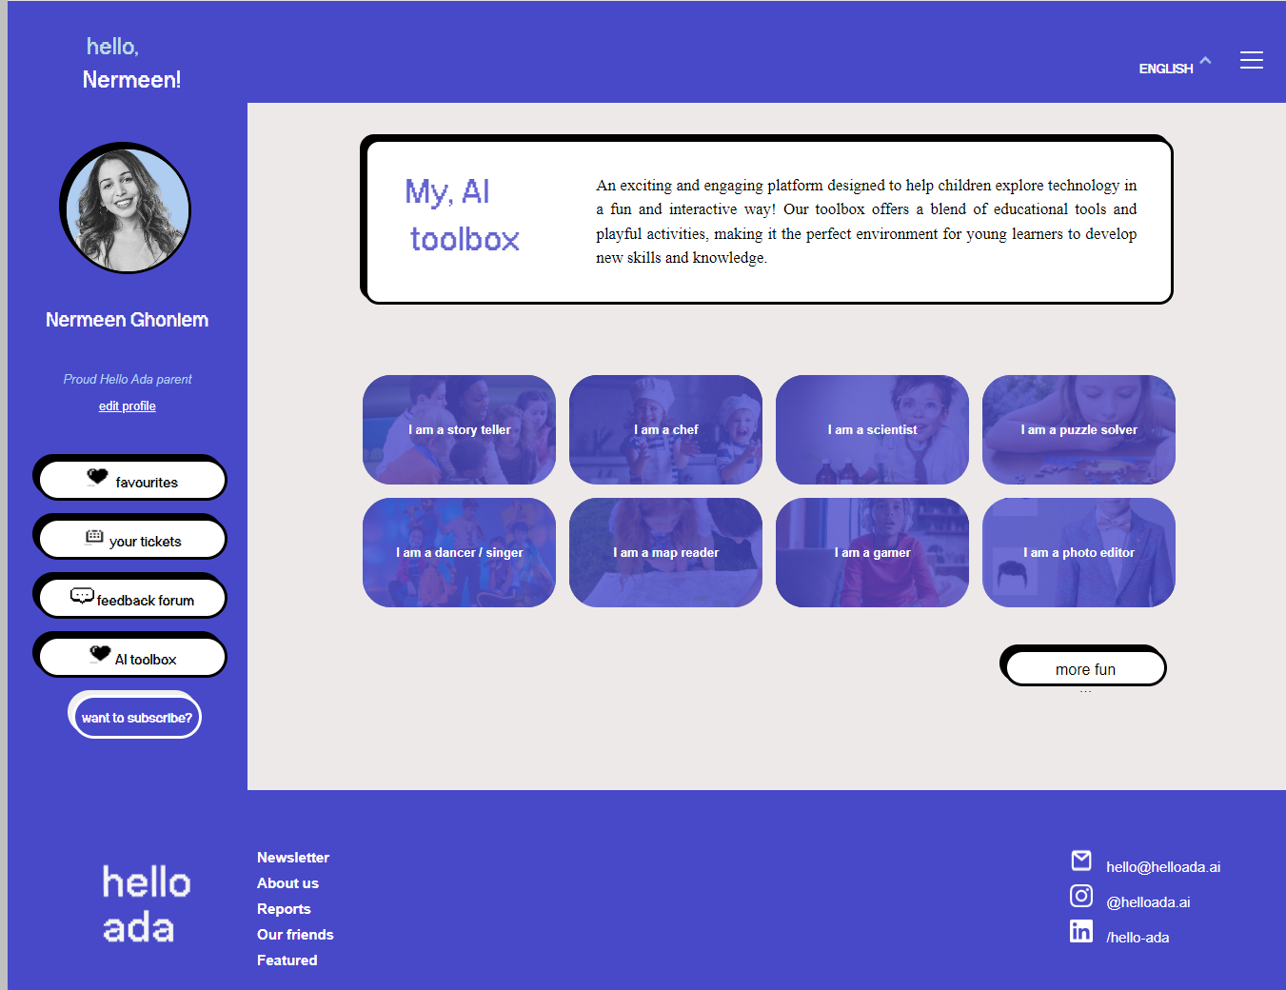
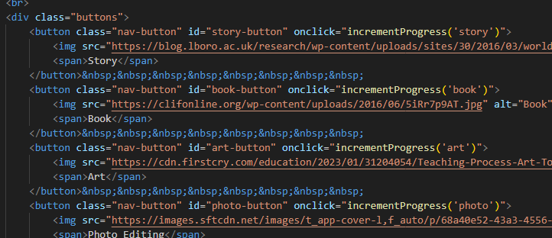
Summary
WE WORKED ON
WIREFRAMES
WRITING CODES

Slide 9
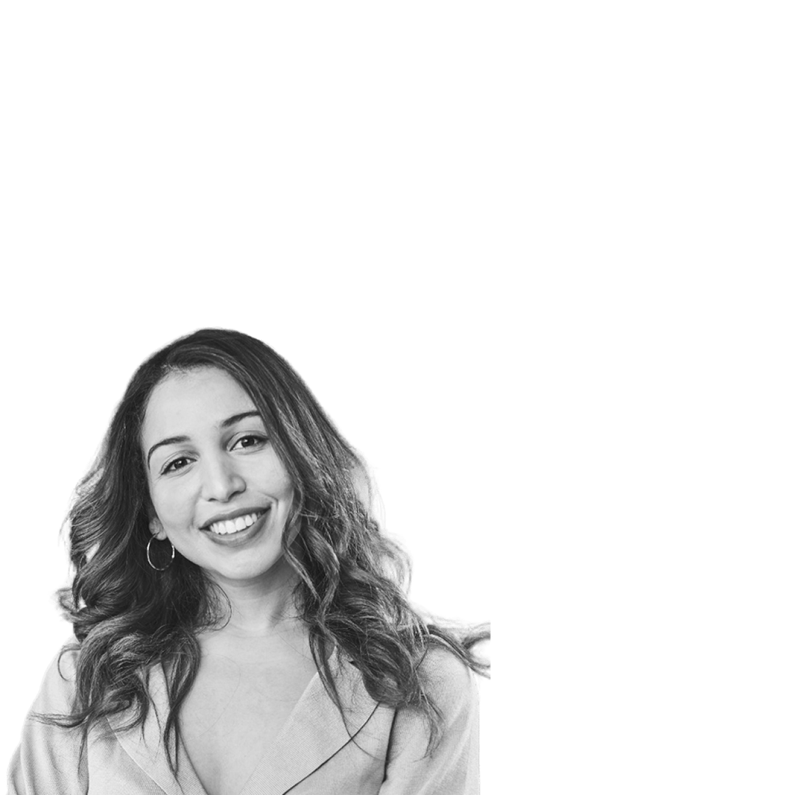

Special Thanks
to
Nermeen Ghoniem

